Slide 1
Modeling of visco elastic deformable objects for virtual environments
Shashi Prakash: B19EE076
Gautam Kumar: B19EE031
Supervisor: Dr. Amit Bhardwaj

Slide 2
Introduction
Haptic processing is initiated by a user's intention to manipulate a physical control in the interior in order to change a certain function.
Gather information about texture, shape, compressibility, and other physical characteristics.

Slide 3
Motivation
The existing methods of Modeling visco elastic deformable objects is very time consuming and less accurate.
There are 2 commonly used existing algorithms for this purpose:
Random Forest with 100 decision trees.
RBF with OMP (Orthogonal Matching Pursuit) based approach.
To solve this problem we have come up with an algorithm which takes less training time and gives more accurate results.

Slide 4
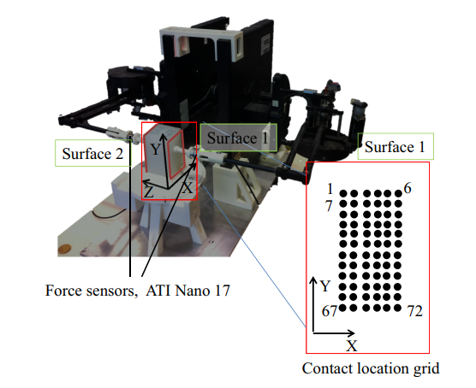
Hardware setup for data collection

Slide 5
Data Description
The outlined automatic data acquisition is performed for all combinations of trajectory parameters, i.e., 3 deformation amplitudes {γ1,γ2,γ3} , 3 angular frequencies {ω1,ω2,ω3} , and 13 phase shifts {ϕj}13j=1, per contact location pair. Thus, there are 3×3×13×2=117×2 discrete-time force curves, obtained from the two force sensors, per contact pair.
In total our 9 datasets consist of 174,672×72×9 interaction data points and force values.

Slide 6
Dataset
We divide the two-finger interaction dataset into TRAINING SET and TEST SET for training and validation based on following characteristics.
1. Deformation Amplitude
2. Indentation frequency
3. Phase
4. Mixed

Slide 7
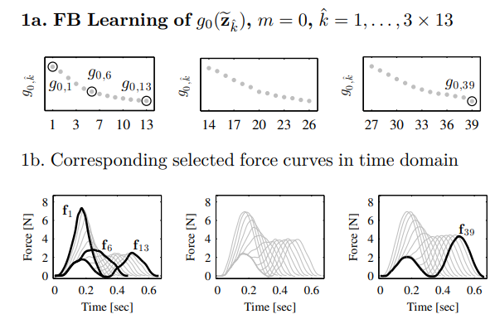
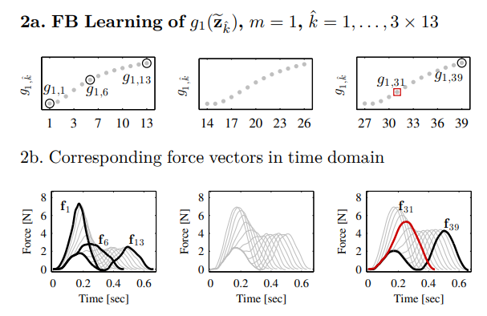
Feature Based Learning Implementation
Source: https://ieeexplore.ieee.org/document/8320317

Slide 8
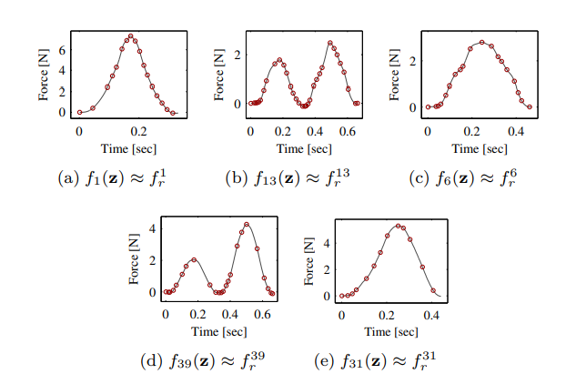
Final Learning on the most informative samples
.

Slide 9
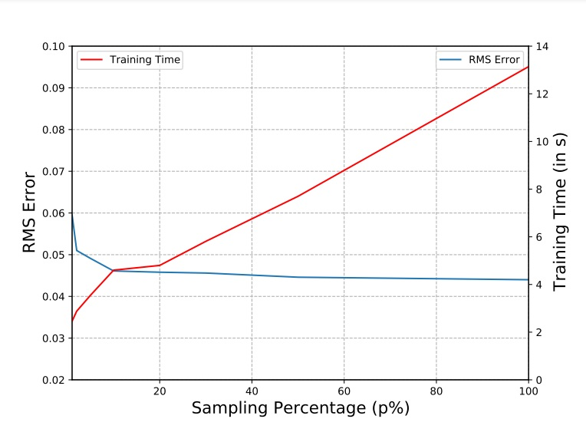
Random Sampling (RS)

Slide 10
Dataset used for different models
Data preparation using MATLAB.
RBF-FBL: For RBF we used Feature Based Learning for data reduction.
RF-RS: For Random Forest, we took current positions (X1, X2) and 4 stages of past position. Then applied Random Sampling by randomly selecting 10% training data.
CAT-RS: For CatBoost we took current position, velocity and filtered velocity as input vector and output vector as force(F1).

Slide 11
Implementation
We have trained and tested various models like Gradient Boosting Regressor, Linear Regression, AdaBoost, XgBoost.
We have also tested the performance of Support Vector Machines and found it to perform significantly well on the given data.
Noticed the training time of each model.
The code and report files are added and updated in the following github repository. https://github.com/gautamHCSCV/Modelling_Viscoelastic_Objects (The repository is private now, it will be released soon).

Slide 12
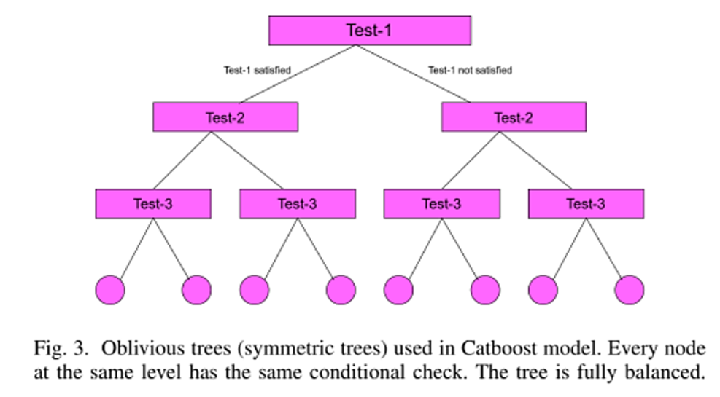
CATBOOST MODEL
Catboost is made of two terms Cat meaning categorical and boost meaning Boosting ensemble technique.

Slide 13
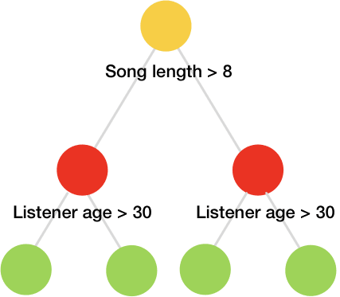
Our hyper-tuned CatBoost model.
CatBoostRegressor(iterations=1200, learning_rate=0.01, bagging_temperature=10)
Decisions Trees are trained sequentially.

Slide 14
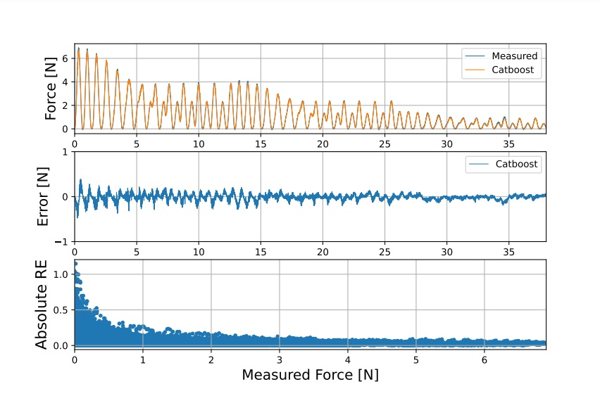
Measured and Predicted Forces

Slide 15
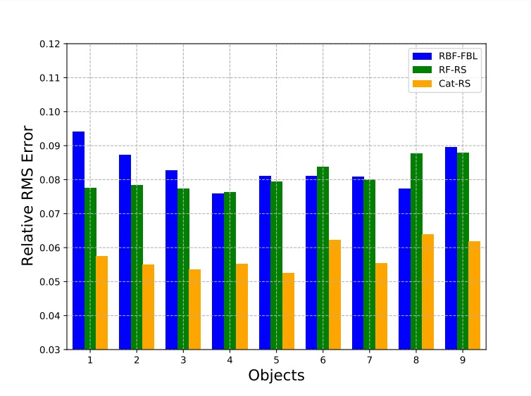
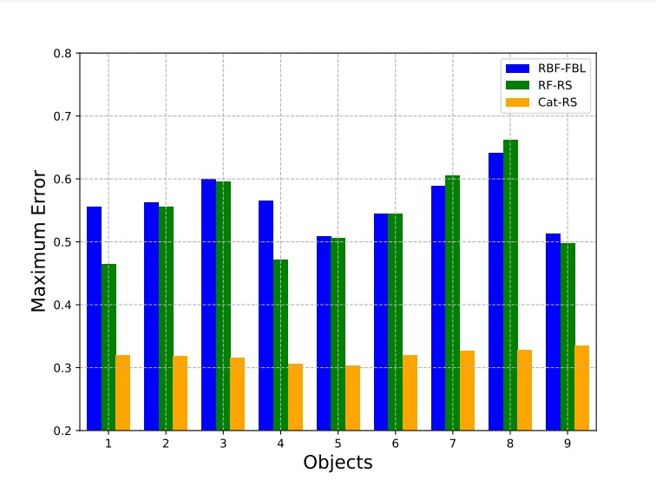
Relative RMSE and Maximum Error comparison

Slide 16
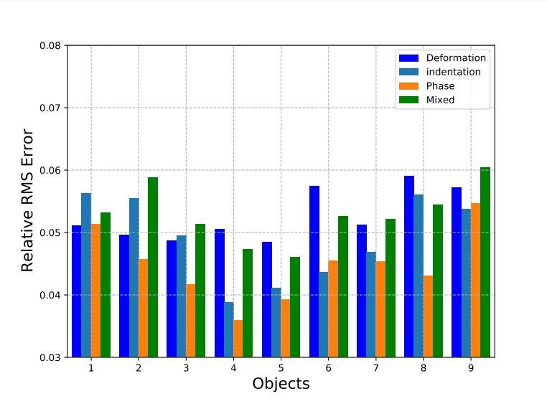
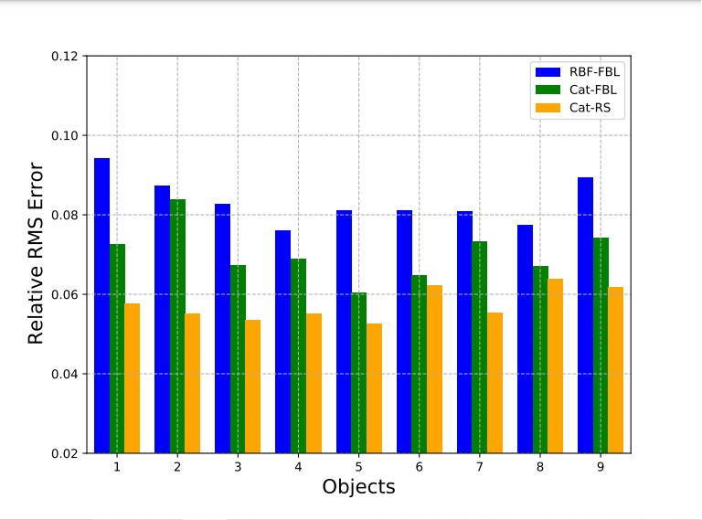
Absolute Relative Error and Cat-FBL comparison

Slide 17
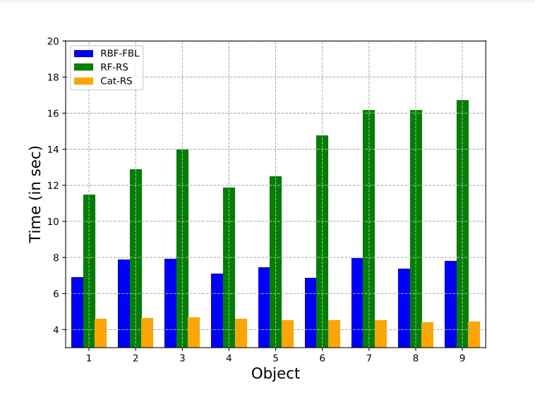
Training Time Comparison

Slide 18
Limitations
Poor extrapolation performance outside the range of training data.
The current approach deals with only normal interactions.
We would test the performance of the CatBoost-based modeling approach for haptic rendering.

Slide 19
Conclusion
CatBoost outperforms RBF and Random Forest on using present data as well as on past data.
We also tested it’s performance on various data reduction techniques like FBL, Random Sampling etc.
The model gets trained in much lower time as compared to other models. This shows that our model is computationally efficient and it can also be deployed on resource constrained environment.
We successfully outperformed state of the art models.

Slide 20
Thank You

